Slide 1
DENGUE DISEASE DETECTION
JNTUA College of Engineering,Pulivendula
CSE Department
Project Guide: T.Niranjan Babu
BY
B.Hari Chandana
Patil Lakshminarayanamma
Sana Babu Reddy

Slide 2
CONTENTS
Introduction
Need for study
Literature survey
Problem statement
Objectives
Existing Systems
Architecture
Dataset Processing
Implementation
Result Analysis
Conclusion
References

Slide 3
INTRODUCTION
Dengue fever is a mosquito-borne disease caused by the dengue virus.
It is a life-threatening disease lots of people died due to dengue.
The challenge is to collect huge volumes of data.
Healthcare can be made smart by using ML in health field.

Slide 4
NEED FOR STUDY
National Vector Borne Disease Control Programme displayed DENGUE SITUATION IN INDIA.
Reference link: https://nvbdcp.gov.in/index4.php?lang=1&level=0&linkid=431&lid=3715
Bihar man blames doctors for dengue deaths
Article Link: https://gulfnews.com/world/asia/india/bihar-man-blames-doctors-for-dengue-deaths-1.67284927
Adya Singh’s dengue death case: Fortis hospital doctor booked
Article Link: https://timesofindia.indiatimes.com/city/gurgaon/adya-singhs-dengue-death-case-fortis-hospital-doctor-booked/articleshow/62014634.cms

Slide 5
Literature survey
Automated Dengue Detection
https://irjet.net/archives/V5/i6/IRJET-V5I689.pdf
Early Detection of Dengue Using Machine Learning Algorithms
https://acadpubl.eu/jsi/2018-118-18/articles/18d/79.pdf

Slide 6
Problem statement
There is a existing system for dengue detection based on weather forecasting but we design a problem with the help of hospital data to predict dengue disease.

Slide 7
OBJECTIVES
1. To propose a automation system for dengue disease detection
2. To collect Real Time Data from Hospitals
3. To Develop a high accuracy prediction model
4. To Design User interface for dengue disease detection

Slide 8
Existed Systems
1. Weather based forecasting
Temperature, rainfall, humidity, precipitations are the major attributes used in this model to identify dengue in particular locations.
2. Image processing of white blood cells
In this model they consider blood cells image only the main attribute.

Slide 9
TECHNOLOGIES USED
Machine Learning Algorithms
Random Forest
Decision Tree
To Implement User interface we are using
Django framework
HTML
Bootstrap

Slide 10

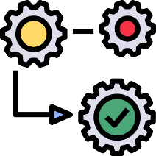









ARCHITECTURE
Collecting Data
Pre-Processing
Data Set
Train the Machine Learning Algorithm
Evaluate
Prediction Model
Input Data
Machine Learning Algorithm
Prediction

Slide 11
Implementation

Slide 12
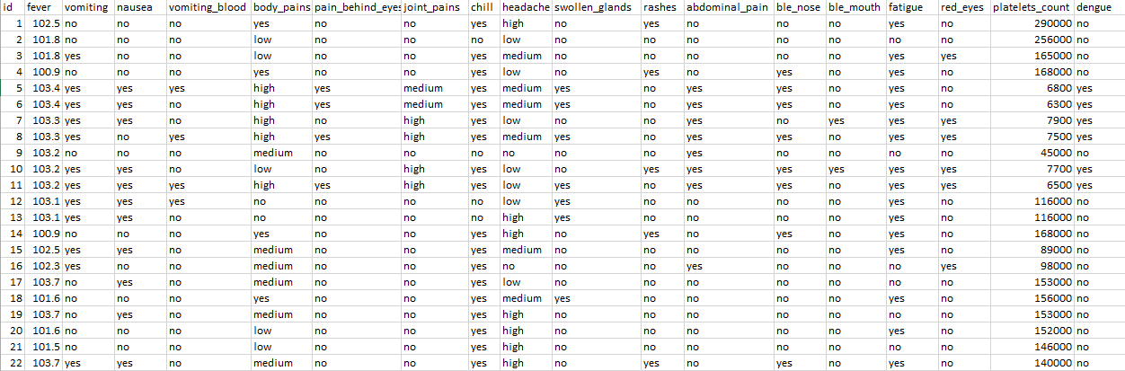
Dataset Description

Slide 13

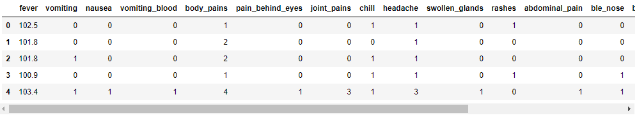
Data Cleaning

Slide 14
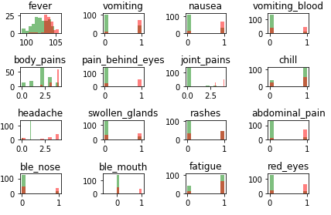
Data Visualization

Slide 15
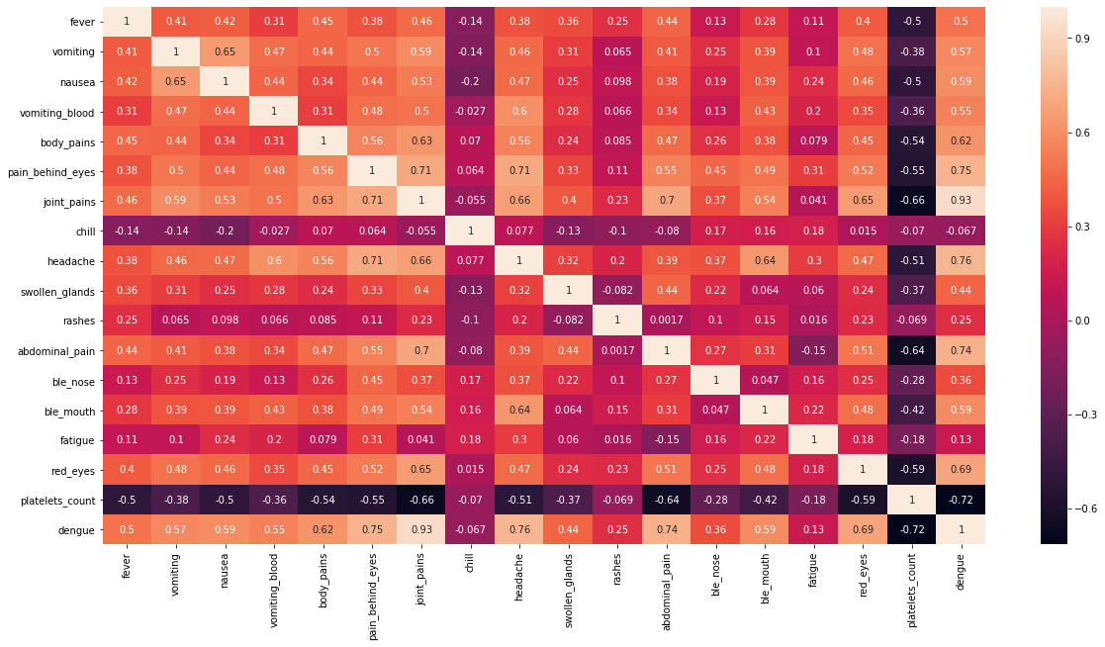
Heat Map Generation

Slide 16
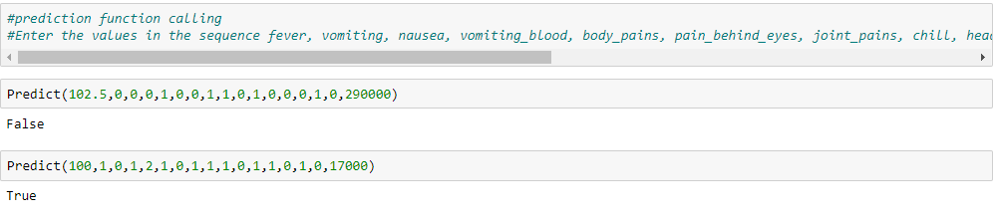
Performing Predictions

Slide 17
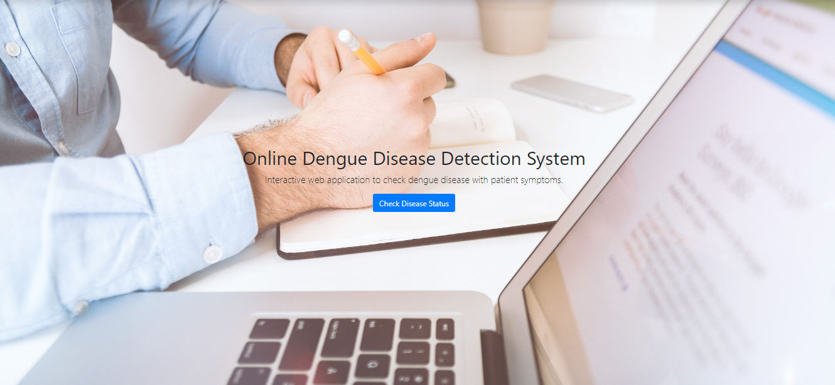
UI Design

Slide 18
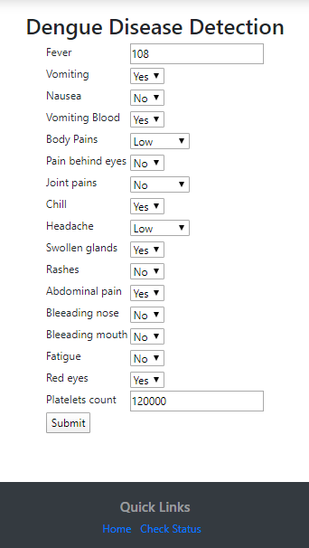
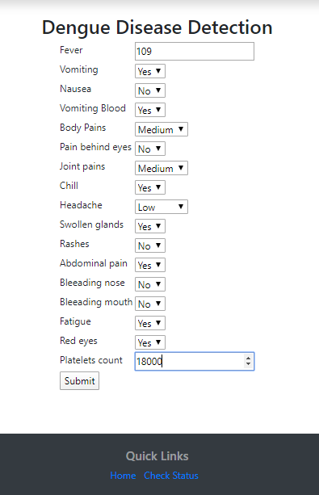
Results

Slide 19


Results

Slide 20
Conclusion
The proposed system is based on the symptoms of dengue disease and it is used to avoid the mistakes or errors of lab technicians. In this the sequence takes place as pre-processing, train the algorithm, prediction, evaluation. In this by taking historical dengue cases to predict to detect the infected or non infected using Random Forest and Decision tree.

Slide 21
References
https://journals.plos.org/plosone/article?id=10.1371/journal.pone.0189988
https://www.hindawi.com/journals/bmri/2013/690835/
https://ieeexplore.ieee.org/document/6361016
https://ij-healthgeographics.biomedcentral.com/articles/10.1186/1476-072X-14-9
https://www.semanticscholar.org/paper/Performance-Comparison-of-Na%C3%AFve-Bayes-and-J-48-Goyal-Mehta/b4eb0794605bea6bb8e0d333a3c1bcfc55616e17
https://www.researchgate.net/publication/2433350_Image_Analysis_and_Supervised_Learning_in_the_Automated_Differentiation_of_White_Blood_Cells_from_Microscopic_Images
https://www.ijert.org/image-processing-based-leukemia-cancer-cell-detection

Slide 22
THANK YOU

